Slide 1
Tax Preparedness &
Preparation
Creatives
Artists
Entrepreneurs

Slide 2
AGENDA
Major Changes in Tax Overhaul
Compliance
Standard vs Itemized Deductions
Business Expense Examples
Expense Tracking
W-2s and 1099s
Estimated Tax Payments
Corporation, Sole Proprietorship, LLC
Questions

Slide 3
MAJOR CHANGES
Standard Deductions
No Personal Exemptions
Lowered Tax Brackets
No Employee Expense Deduction
Max Property/Income Tax Paid
Qualified Business Income (QBI) Credit

Slide 4
COMPLIANCE
WHO MUST FILE?
Did you earn at least $12,000?
Did you have self-employment income of at least $400?
WHO SHOULD FILE?
Did you have income tax withheld?
Are you eligible for earned income credit?

Slide 5
A LESSON IN COMPLIANCE
You Don’t File $26,000 on 1099
IRS Files on Your Behalf
IRS Bill of $5,500 + Penalties and Interest
You Do File $26,000 on 1099
Include Expenses – Cell, Internet, Mileage
IRS Bill Reduced by $1,500
No Penalties, No Interest

Slide 6
STANDARD VS ITEMIZED
Standard Deduction
Single – $12,000
Head of Household - $18,000
Married Filing Jointly - $24,000
Itemized Deduction (Schedule A)
State Income Tax Withheld
Property Tax
Mortgage Interest
Charitable Contributions
Notes:
Medical Deductions
Unreimbursed Employee Related Expenses

Slide 7
BUSINESS EXPENSE EXAMPLES
Mileage
Supplies
Business Cards, Website Expenses
Registration Fees
Internet, Cell Phone
Research/Inspiration
Cable Subscription, Books, Travel
Studio/Home Office
Meals
Training/Workshops

Slide 8
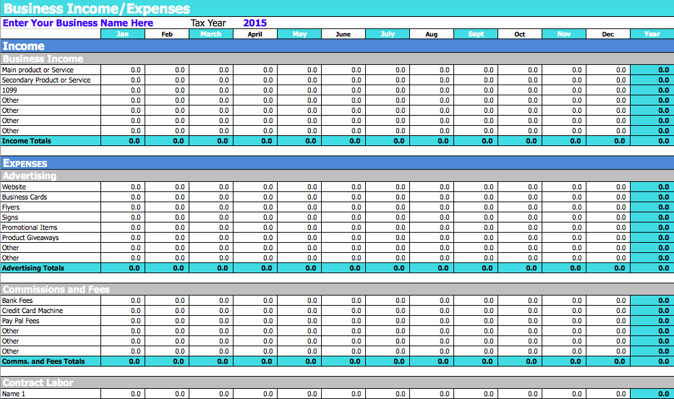
EXPENSE TRACKING

Slide 9
W-2s and 1099s
W-2s
Employee
Employment Taxes Withheld
Income Tax Withheld
Information Gathered from W4
1099s
Contractor
No Employment Taxes Withheld
Income Tax Might Be Withheld
Information Gathered from W9

Slide 10
ESTIMATED TAX PAYMENTS
Do you expect to owe more than $1000?
March 31, May 31, August 31, December 31
Due April, June, September, January 15
Small Penalty

Slide 11
CORPORATION or SOLE PROPRIETORSHIP
Corporation
Separate Discrete Entity
Sole Proprietorship
Segment of Personal Tax Return
LLC
Limited Liability Corporation

Slide 12
QUESTIONS ???
Esohe Galbreath
404-849-3529 (cell)
info@sohesolutions.com

